Slide 1
Chapter 14
Social Relationships
Notes:
Add slide notes here

Slide 2
Reminder: Attachment Styles
Attachment
  Secure attachment style: have positive view of relationships and find it easy to get close to others
  Avoidant attachment style: hesitant about getting involved in romantic relationships
  Anxious attachment style: demand closeness, less trusting, more emotional, jealous, possessive

Slide 3
Friendships
Three themes of friendship:
  Affective or emotional: self-disclosure, expressions of intimacy, appreciation, and support; requires trust and commitment
  Shared or communal nature: mutual interests
  Sociability and compatibility: source of fun and entertainment
Reciprocity and choice!
How does forming friendships change over the lifespan?

Slide 4
Friendships In Adulthood
Friendships often change across adulthood
Life transitions often result in fewer friendships and less contact with remaining friends
People generally have the most friends during young adulthood

Slide 5
Romantic Relationships
Robert J. Sternberg’s Triarchic Theory of Love
  Three dimensions of love: passion, intimacy, and commitment
    Infatuation: passion, no intimacy and commitment
    Affectionate love: combination of intimacy and commitment, no passion
    Fatuous love: passion and commitment without intimacy
    Consummate love: strongest, fullest form of love with passion, intimacy, and commitment (Combination of all three types)

Slide 6
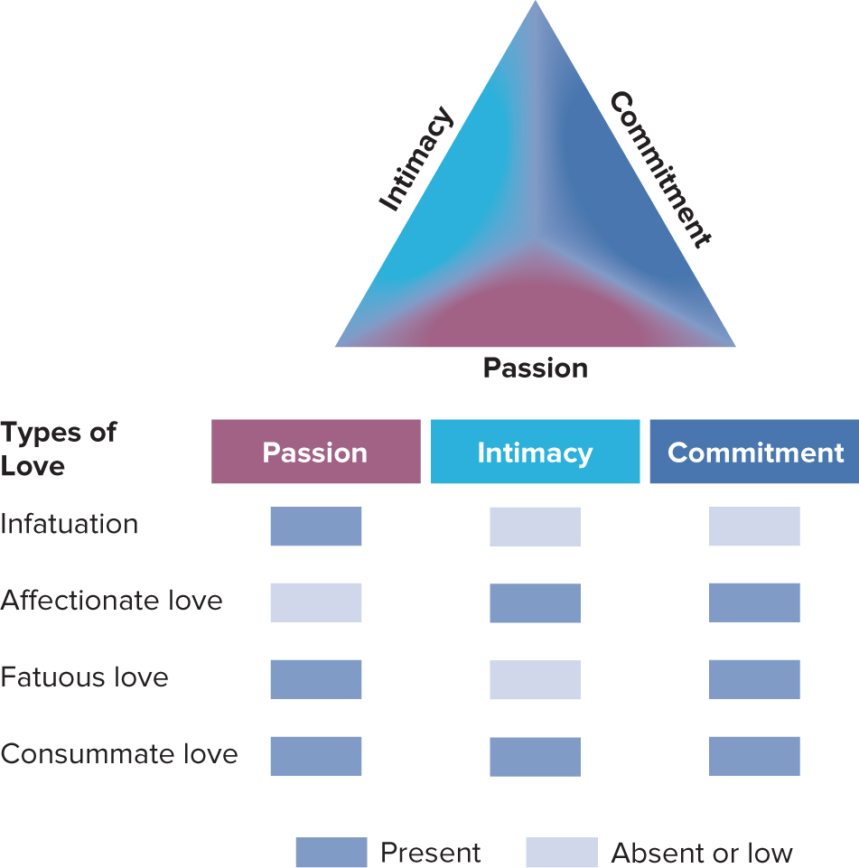

Slide 7
Love Through Adulthood
Early in romantic relationships:
  Passion is high, but intimacy and commitment are lower
  Higher divorce rates in couples who marry based primarily on infatuation
Assortative mating: selecting one’s partner based on similarity across many dimensions
  Homogamy: degree to which people are similar; greater when couples meet through school or a religious setting

Slide 8
The Family
Family systems theory: The family is a whole consisting of interrelated parts, each contributing to the whole.
  Nuclear family: Consists of father, mother, and at least one child, now called the “immediate family”
  Alloparenting: Parenting by multiple caregivers
  Extended family household: In which parents and their children live with other kin (grandparents, aunts, uncles, etc.)

Slide 9
How Couples Tend to Meet: Past and Present
Notes:
Figure 9.3 How Couples Tend to Meet: Past and Present
Source: Rosenfeld et al., 2019.

Slide 10
A Changing System in a Changing World (1 of 2)
Trends in the United States
  More single adults
    Never married—20% of adults age 25 and older
  More postponed marriages
    1960—age 20 for women, 23 for men; 2019—age 28 for women, 30 for men
  More unmarried parents
    40% of births in 2017 were to unmarried women
  Cohabitation: Living with a romantic partner without being married has been steadily increasing

Slide 11
A Changing System in a Changing World (2 of 2)
Trends in the United States
  Fewer children
  More working mothers
    1950—12%; 2019—66%
  More divorce
    Over 40% of newly married couples can expect to divorce
  More single-parent families
    In 2018 up to 22% younger than 18 lived with their mother only, 4% with fathers, and 4% with nonparents

Slide 12
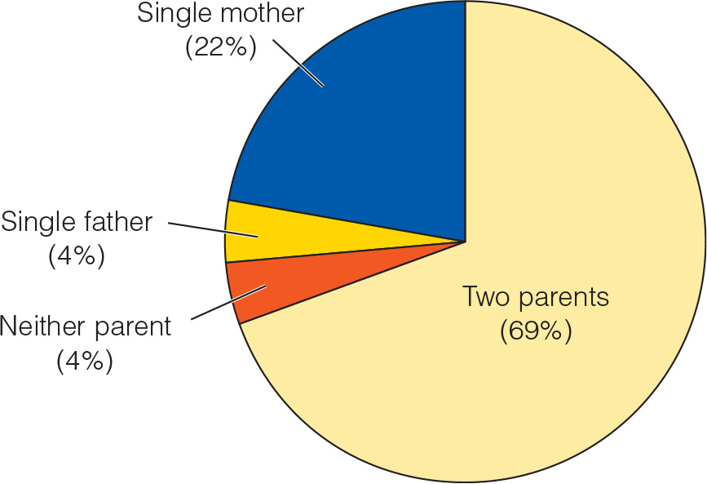
A Changing System in a Changing World (Children From Birth to Age 17)
Notes:
Figure 15.1 Percentage of children from birth to age 17

Slide 13
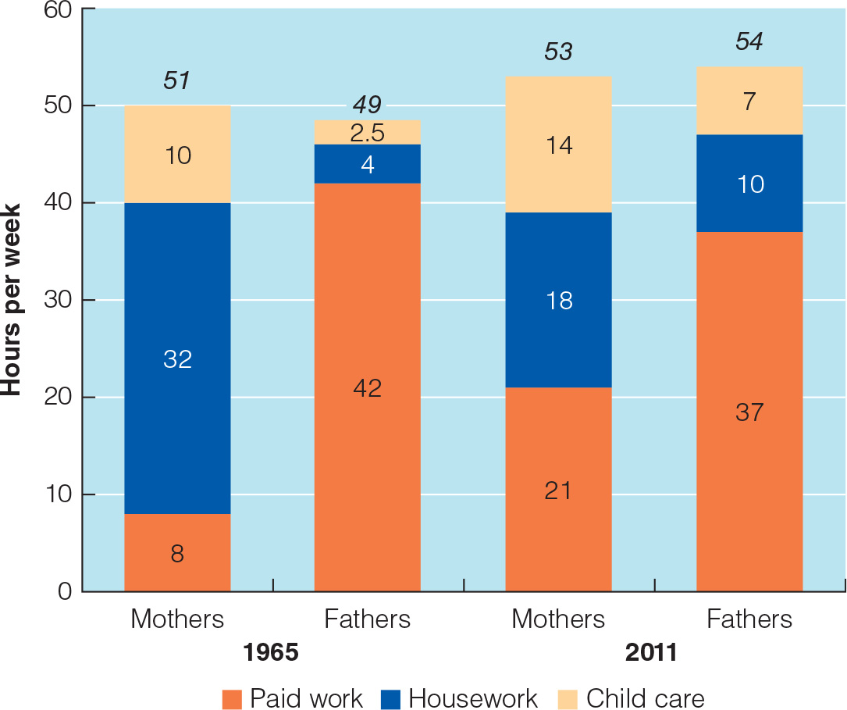
Mothers and Fathers
Notes:
Figure 15.2 Changes in time use of mothers and fathers between 1965 and 2011

Slide 14
Parenting Styles (1 of 2)
Two dimensions of parenting
  Parental acceptance−responsiveness (Warmth)
    Extent to which parents are warm, supportive, and sensitive to their children’s needs
  Demandingness (Control)
    How much control over decisions lies with the parent as opposed to with the child

Slide 15
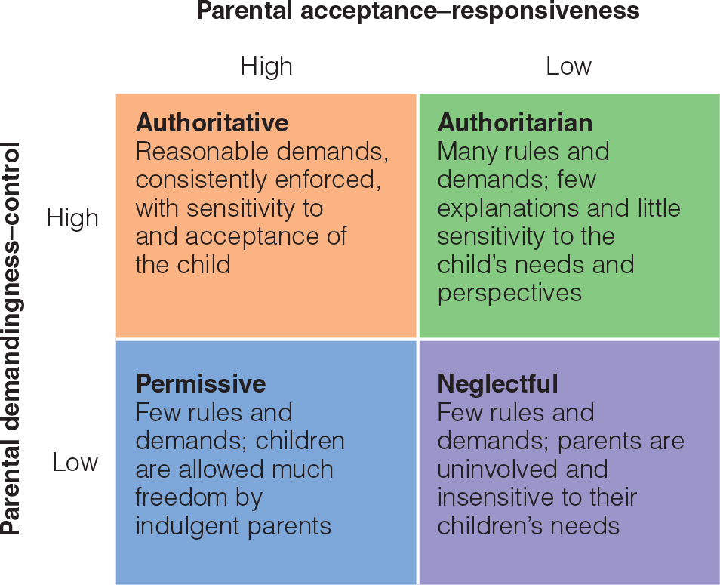
Parenting Styles (2 of 2)
Notes:
Figure 15.3 The acceptance–responsiveness and demandingness–control dimensions of parenting
Activity: Which parenting style do you think would be the best for raising a child? What about the worst? Why?

Slide 16
Models of Influence in the Family (1 of 2)
Parent effects model of family
  Influences run one way, from parent (particularly mother) to child
Child effects model of family influence
  Highlights the influences of children on their parents

Slide 17
Models of Influence in the Family (2 of 2)
Interactional model
  Recognizes that parent and child characteristics may combine in certain ways to influence development
  Gene−environment interaction
Transactional model of family influence
  Parent and child are seen as influencing one another reciprocally over time.

Slide 18
Sibling Relationships (1 of 2)
Arrival of a sibling
  Most adjust well
    60% of firstborns coped well
    31% found the experience threatening
  Temporary decreases in children’s affection for and responsiveness to their mothers

Slide 19
Sibling Relationships (2 of 2)
Four functions of siblings
  Emotional support
  Caregiving
  Teaching
  Social experience
Indirect effects
  Older competent sibling → mother’s positive psychological functioning → supportive parenting → competent younger sibling

Slide 20
Ripples in the Parent‒Child Relationship
Most parent‒child relationships are close
  Do change during adolescence
  Conflict increases temporarily during puberty
    Mainly about minor matters, such as homework, chores, and disobedience
  Adolescents spend more time with peers.

Slide 21
Achieving Autonomy
Key developmental task during adolescence
  Achieving autonomy
  Adolescents in both individualistic and collectivist cultures strive for autonomy.
Authoritative parenting style
  Gives adolescents opportunities to strengthen their independent decision-making skills while retaining the benefit of their parents’ guidance
  Helicopter parenting style. Overparenting, involves developmentally inappropriate levels of control and assistance

Slide 22
Singles
Majority of young adults are unmarried.
  Run the risk of being lonelier than most adults in later life
Reasons for cohabitation
  Convenience
  Trial marriage
  Alternative to marriage
Adults who are single by choice are self-supporting and are satisfied with their lives.

Slide 23
Establishing a Partnership
Between 80 and 90% of adults choose to marry at some point. However, the percentage of adults living with a spouse has fallen.
First year of marriage
  Perceptions of the marital relationship less favorable
  Marital satisfaction declines
Couples most likely to survive when they maintain a high level of positive and supportive interaction

Slide 24
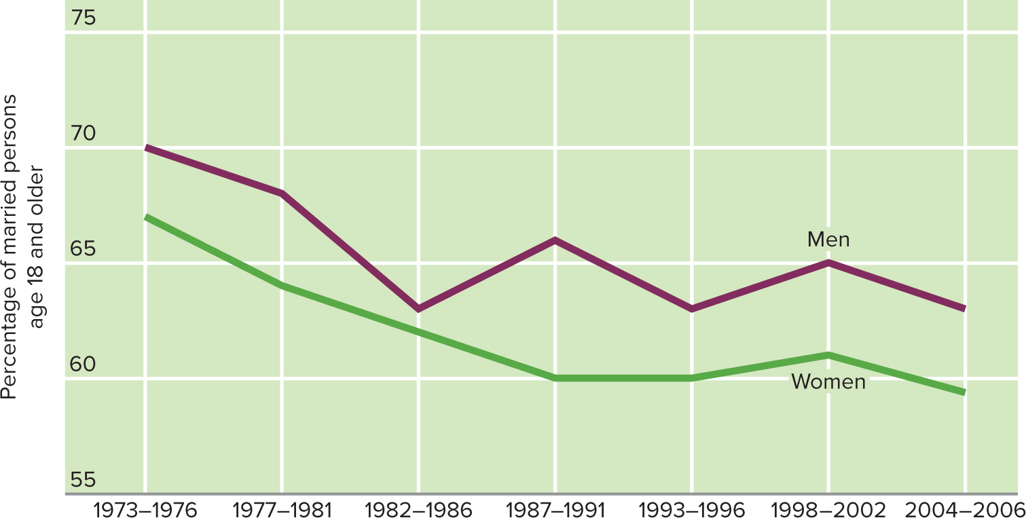
Percentage of Married Persons Age 18 and Older with “Very Happy” Marriages

Slide 25
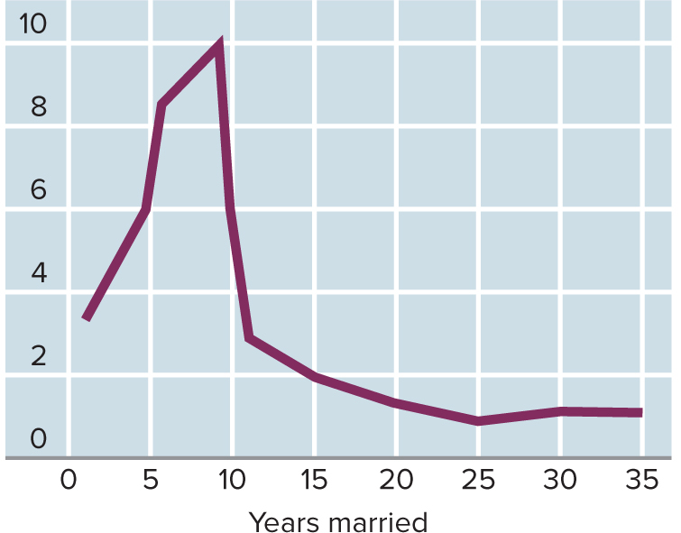
The Divorce Rate in Relation to Number of Years Married

Slide 26
Divorcing Families
Couples at highest risk for divorce
  Younger (20s and 30s)
  Married for an average of only about seven years
  Have young children
These couples feel their marriages lack communication, emotional fulfillment, or compatibility

Slide 27
Divorcing Families (2 of 2)
Divorce is typically a one- to two-year crisis
Divorced adults are at higher risk for:
  Depression
  Psychological distress
  Physical health problems
  Even death

Slide 28
Reconstituted Families
Within three to five years after a divorce, 75% of single-parent families acquire a step-parent
About 60% of remarried couples divorce
  Recurring cycles of singlehood, cohabitation or marriage, conflict, and separation or divorce
One-third of adults find remarriage more stressful than divorce.

Slide 29
Childless Married Couples
Childlessness does not diminish the well-being of adults
  Sometimes boosts it
    Marital satisfaction higher than couples with children during childrearing years
Children do not guarantee happiness; not having children does not mean unhappiness.

Slide 30
New Parenthood
By age 40 to 44
  85% of women in the United States have given birth to a child
  80% of men have fathered a child
New parenthood is a stressful transition
  Parents who cope adaptively
    Have an easy baby
    Possess positive personal qualities and coping skills
    Receive reliable support from their partners

Slide 31
The Childrearing Family
Children have a slightly negative effect on marital satisfaction
  Stress of parenting
  Claims energy from marital relationship
Parents
  Emphasize the positives about parenthood
  Feel it has contributed a great deal to their personal development

Slide 32
The Empty Nest
Parents react more positively than negatively to children leaving home
  Fewer roles and responsibilities
  More opportunity to focus on their marital relationship
  Evidence they have done their job as parents
Boomerang Children
  In recent years, an increasing number of young adult children remain in the nest or come back
  Over 30% of people aged 18 to 34 live with parents.

Slide 33
Changing Responsibilities
Caring for aging parents
  Middle generation squeeze: To describe the situation of middle-aged adults pressured by demands from other generations
  Traditional gender roles call for women to be “kinkeepers”
  Caregiver burden: Psychological distress associated with the demands of providing care for someone with impairments

Slide 34
Grandparenthood
Three major styles of grandparenting
  Remote
    Geographically and emotionally distant
  Companionate
    Most common style
    See grandchildren frequently, enjoy activities with them
  Involved
    Often help with child care, give advice, and play other practical roles in their grandchildren’s lives

Slide 35
Relationships in Older Adulthood
Disengagement theory: incorrect belief that older adults disengage from society—and society disengages from them—as they anticipate death.
Activity theory: reductions in social interaction as an involuntary result of social barriers to engagement.
Socioemotional selectivity theory: with age, information-sharing aspects of social interaction are less important than emotion-regulation aspects.
Notes:
LO 14-5: Examine changes in social relationships change over the lifespan.
D. Older Adult’s Changing Social World
a. Disengagement Theory
i. Disengagement theory: a commonly held, though incorrect, belief
that older adults disengage from society—and society disengages from them—as they anticipate death
b. Activity Theory
i. Activity theory: the assertion that reductions in social interaction
as an involuntary result of social barriers to engagement
ii. Older adults replace lost social roles to stay active, busy, and
healthy (require quality activities, such as volunteering)
iii. People are motivated to adapt as needed to maintain a sense of
continuity, and older adults tend to seek routine
c. Socioemotional Selectivity Theory
i. With age, information-sharing aspects of social interaction are less
important than emotion-regulation aspects
ii. As perceived time left diminishes, adults become increasingly
motivated to derive emotional meaning and cultivate emotionally close relationships

